Slide 1
Data-driven diagnosis of serious bacterial infection: what are we predicting, when and why?
Stephen Aston
Senior Clinical Lecturer and
Consultant in Infectious Diseases

Slide 2
Outline
No data – Sorry!
Background
Current applications of data-driven diagnosis for sepsis/serious bacterial infection (SBI)
Defining SBI for ML model development
Planned study
Discussion

Slide 3
Current approach to sepsis assessment
No screening tool is perfect!
Positive sepsis screening tool
Positive sepsis screen (NEWS2 ≥5 and/or Red Flag) but no infection.
At least 20% of patients with positive sepsis screen do not have infection.
No benefit and potential harms from antibiotics
Infection but
not sepsis
Fundamental problem:
Severity assessment without unbiased estimate of infection likelihood
Negative sepsis screen (NEWS2 <5 and no Red Flag) but sepsis present
Need to be mindful that screening tools are not 100% sensitive
‘Sticky diagnoses’
Prescribing etiquette
‘Culture-negative’ sepsis
Sepsis
Septic Shock

Slide 4
Can we move beyond standardized ‘one-size-fits-all’ risk scores and single biomarkers in sepsis assessment and leverage the richness of structured data within electronic health records to estimate likelihood of severe bacterial infection to guide initial management decisions?

Slide 5





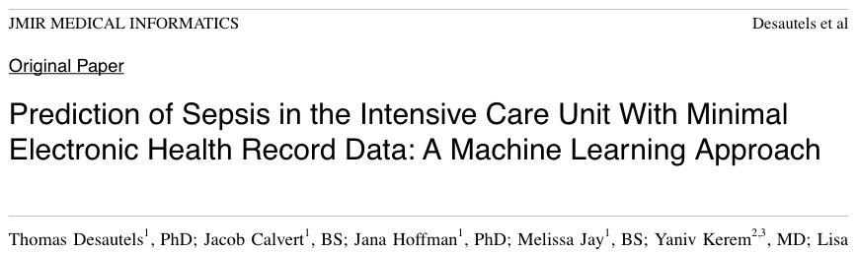
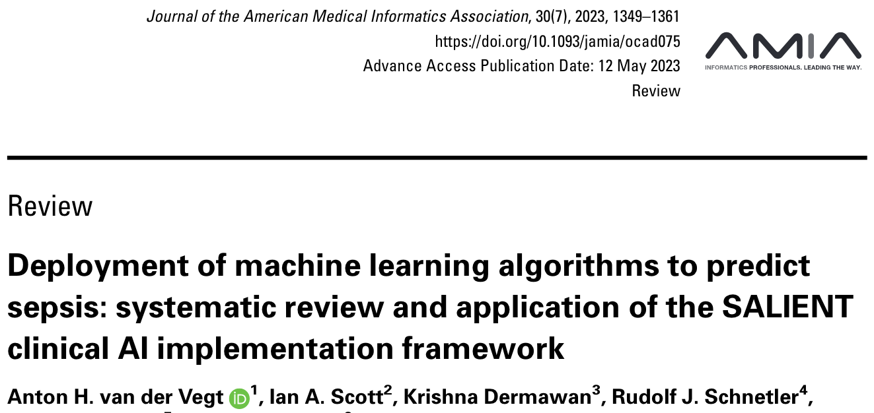



Sepsis prediction

Slide 6
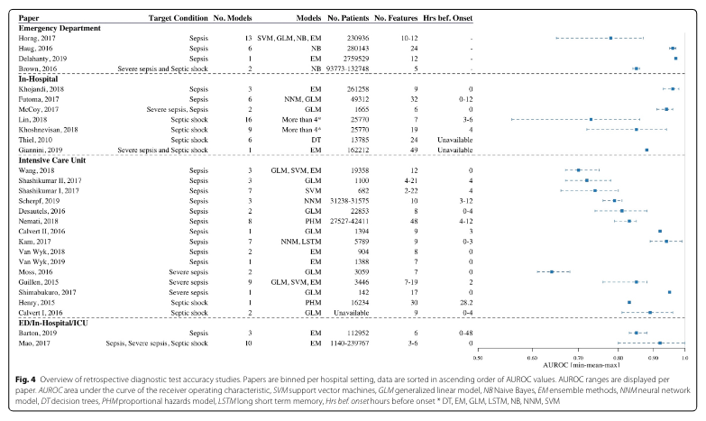
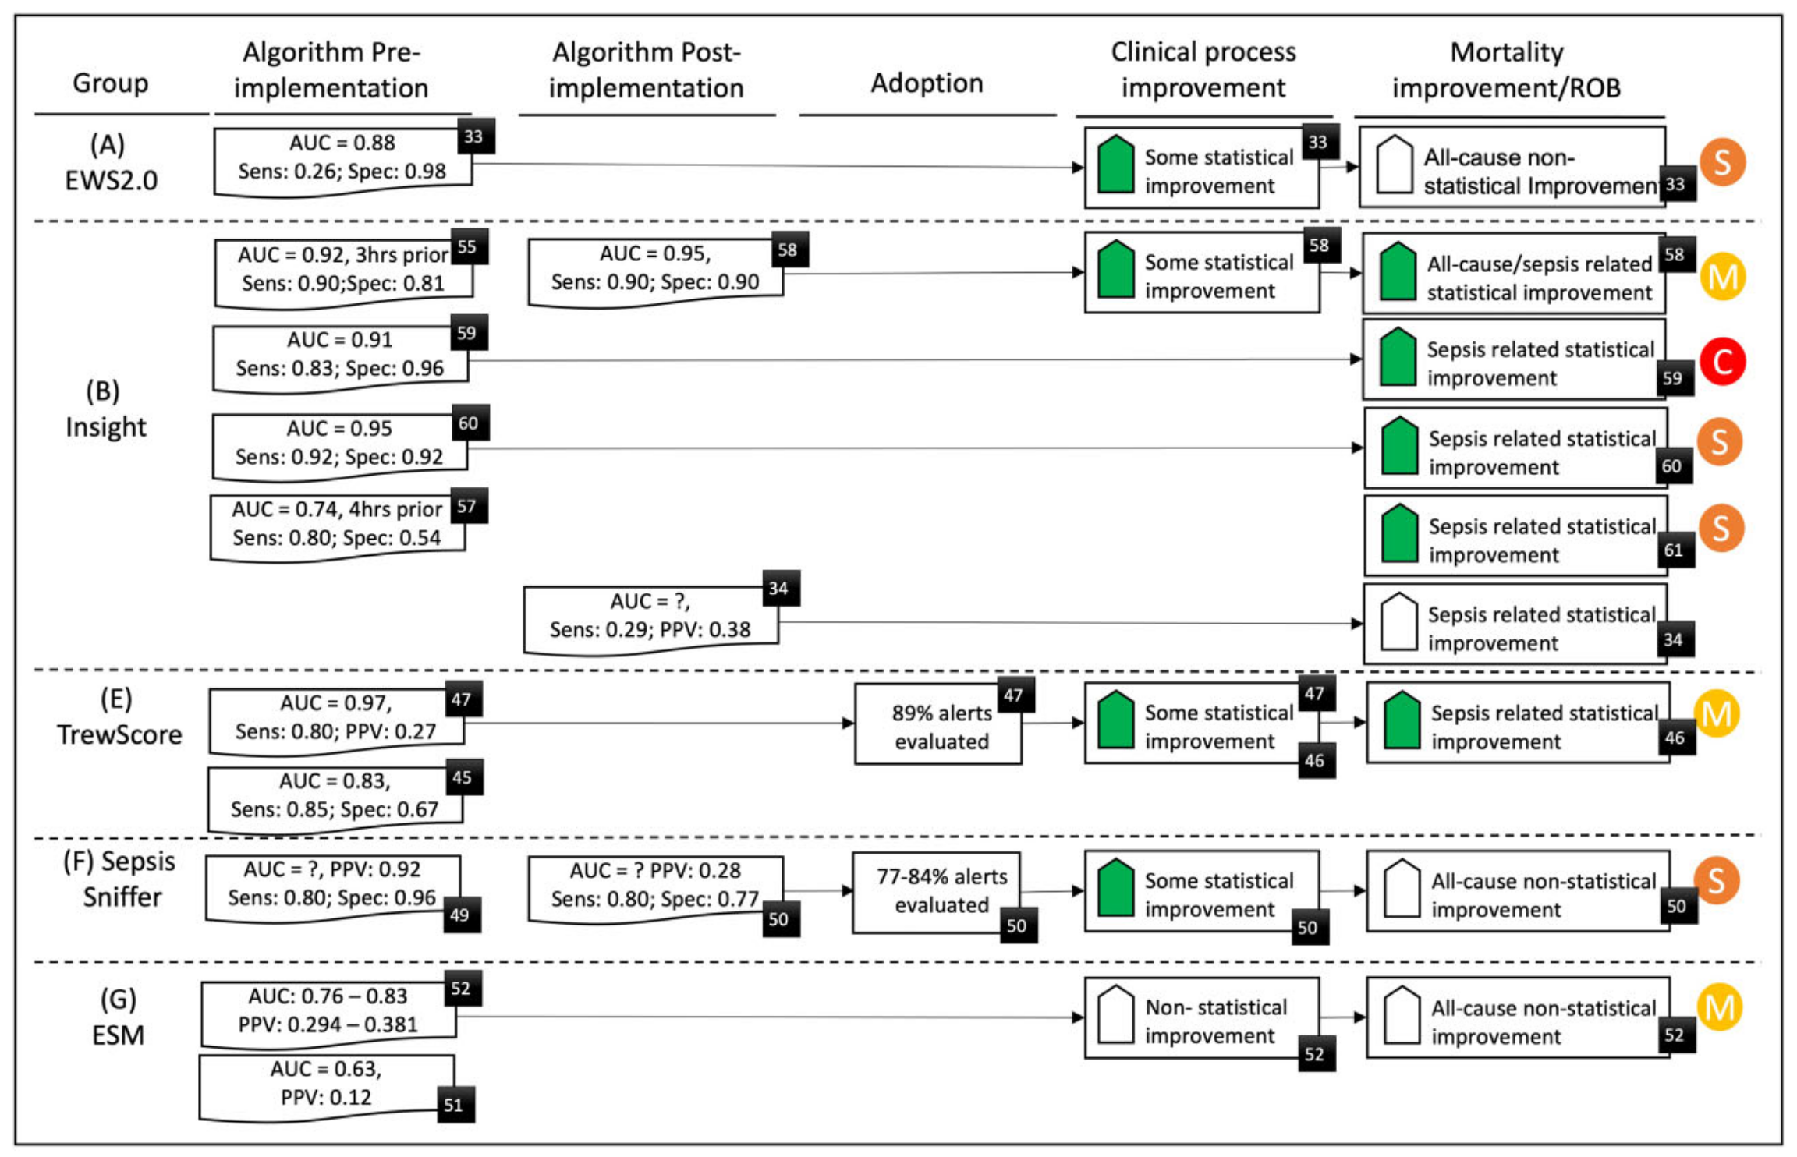
Sepsis prediction
Limited evaluation prior to rollout
ICU predominant
Predict onset of sepsis (i.e. organ dysfunction) rather than infection diagnosis.
‘All comer’ vs ‘infection suspected’ population.
Fleuren et al., ICM 2020; van der Vegt et al., JAMIA 2023

Slide 7
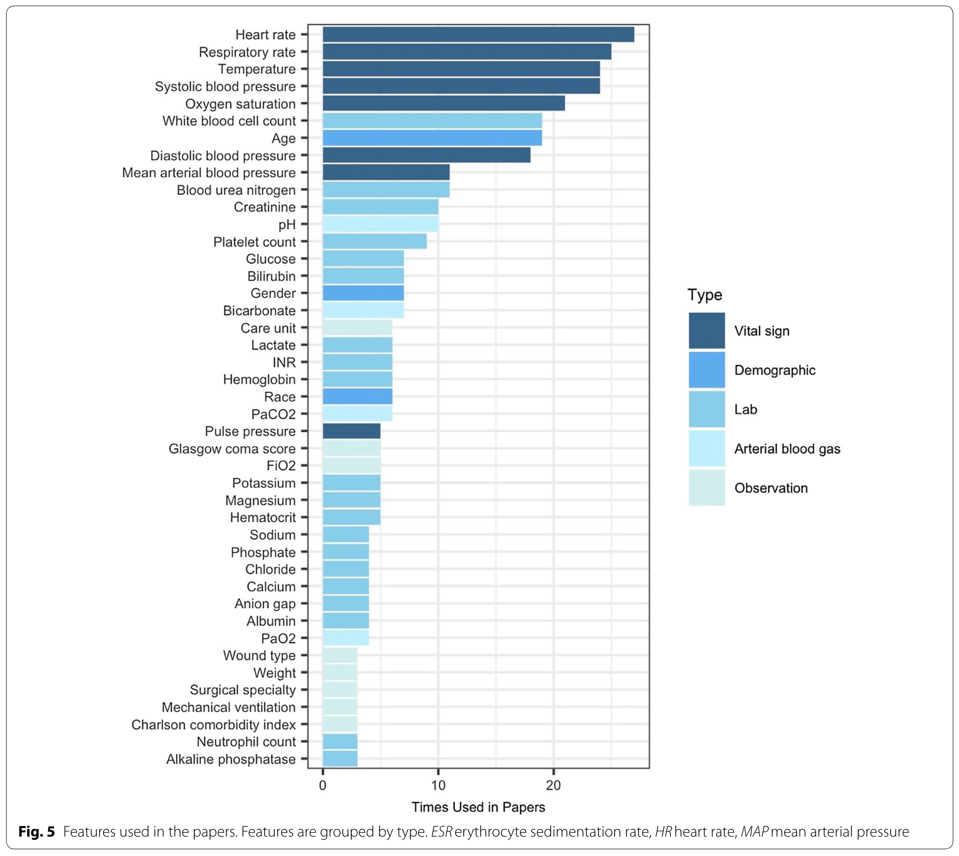
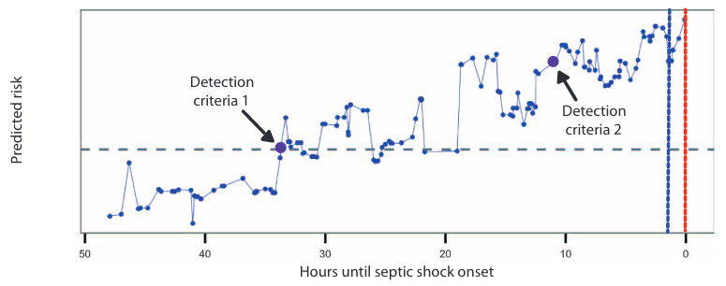
Sepsis prediction
Feature set / parameters typically limited to acute physiology and lab parameters.
Focus – early detection and treatment initiation; Prediction time frame up to onset of septic shock.
Henry et al. Sci Trans Med 2015; Fleuren et al., ICM 2020

Slide 8

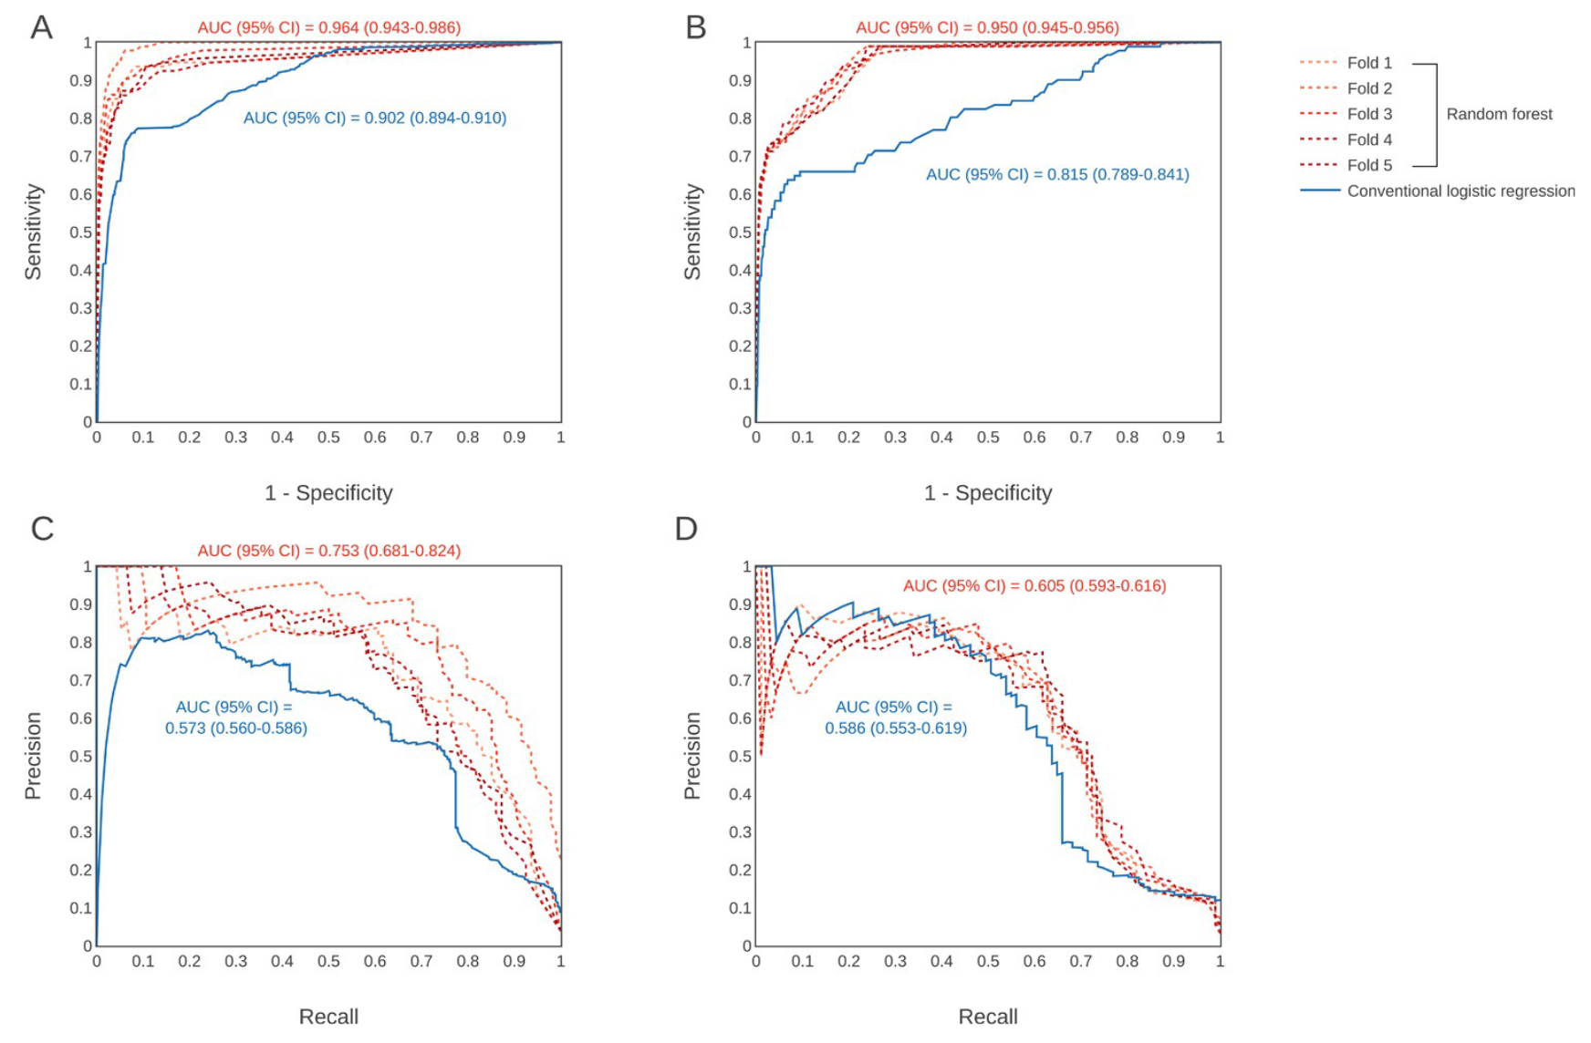
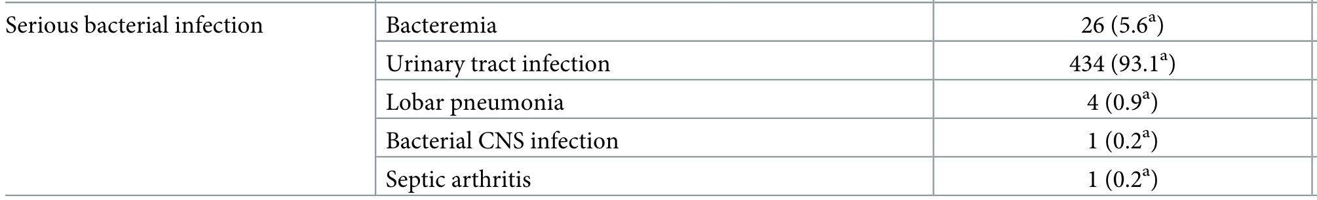
Serious bacterial infection diagnosis
Serious Bacterial Infection
Bacteremia defined by growth of a single bacterial pathogen;
Acute pyelonephritis defined by growth of a single bacterial urinary tract pathogen at ≥ 10⁵ cfu/mL and presence of a renal involvement on DMSA scan, or by any bacterial growth on urine obtained by suprapubic aspiration or ≥ 10⁴ colony-forming units/mL of a single pathogen on urine obtained by bladder catheterization;
Lobar pneumonia diagnosed on chest radiography;
Bacterial meningitis with a positive cerebrospinal fluid culture;
Bone or joint infections defined as local isolation or isolation in blood culture of a microorganism with concomitant arthritis;
Sepsis defined according to Levy et al.

Slide 9

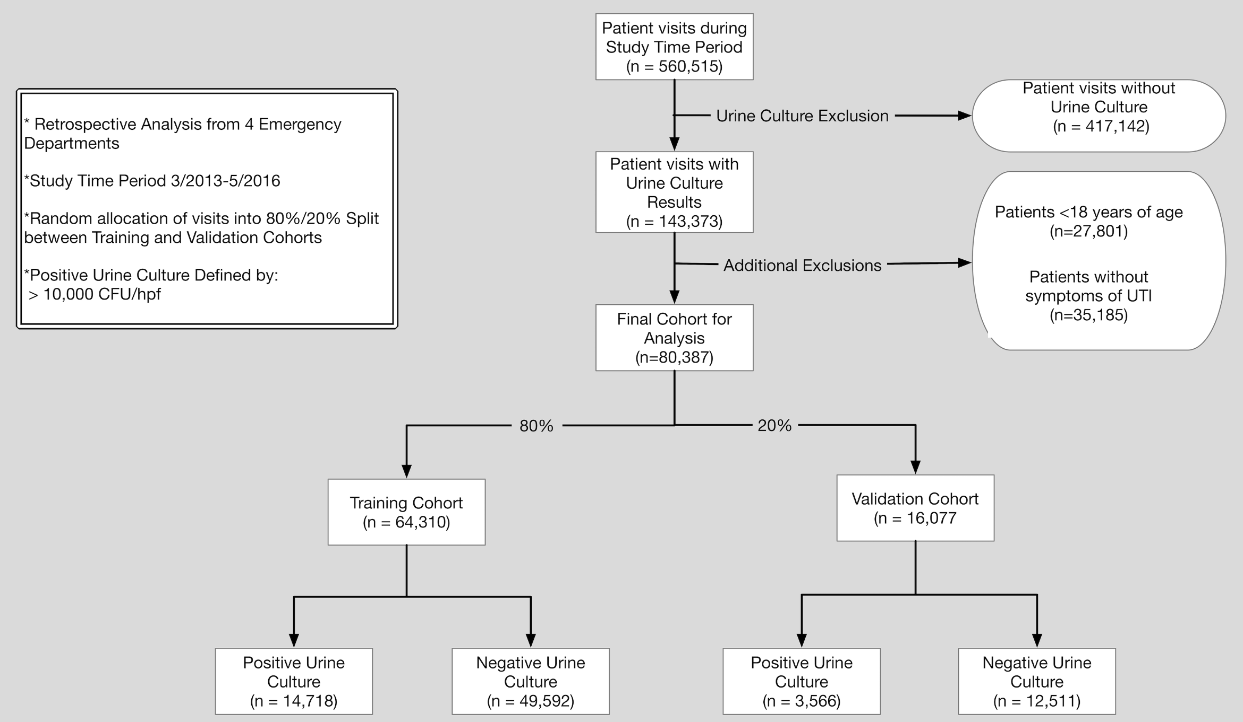
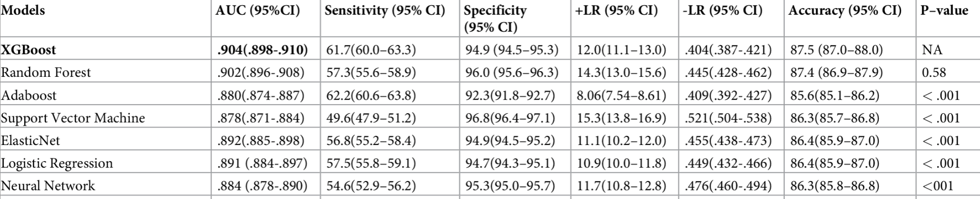
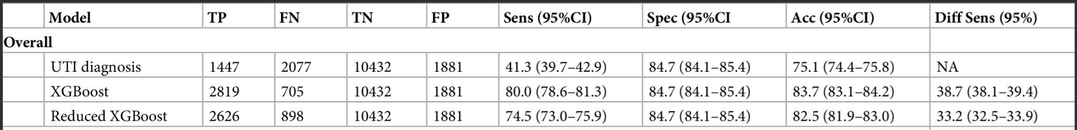
Syndrome-specific diagnosis
Retrospective cohort of ED visits with symptoms potentially attributable to a UTI and urine culture results.
Primary outcome: positive urine culture with >10⁴ CFU/HPF
Secondary: (1) provider documentation of UTI diagnosis; (2) provider gave antibiotics OR documented a diagnosis of UTI.
Predictor variables: demographics, vitals, lab results, urinalysis results, outpatient medications, past medical history, chief complaint, and structured historical and physical exam findings
Models developed using full (211 variables) and reduced (10 variables) variable sets. Reduced selected a priori
Machine learning approach: Several different models; 10-fold cross validation; trained and validated on a random 80%/20% split.
Taylor et al., PLoS ONE 2018

Slide 10
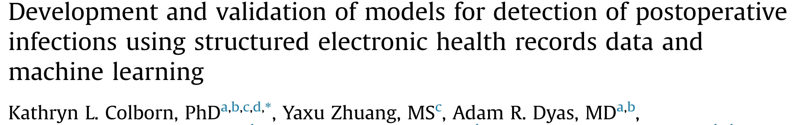
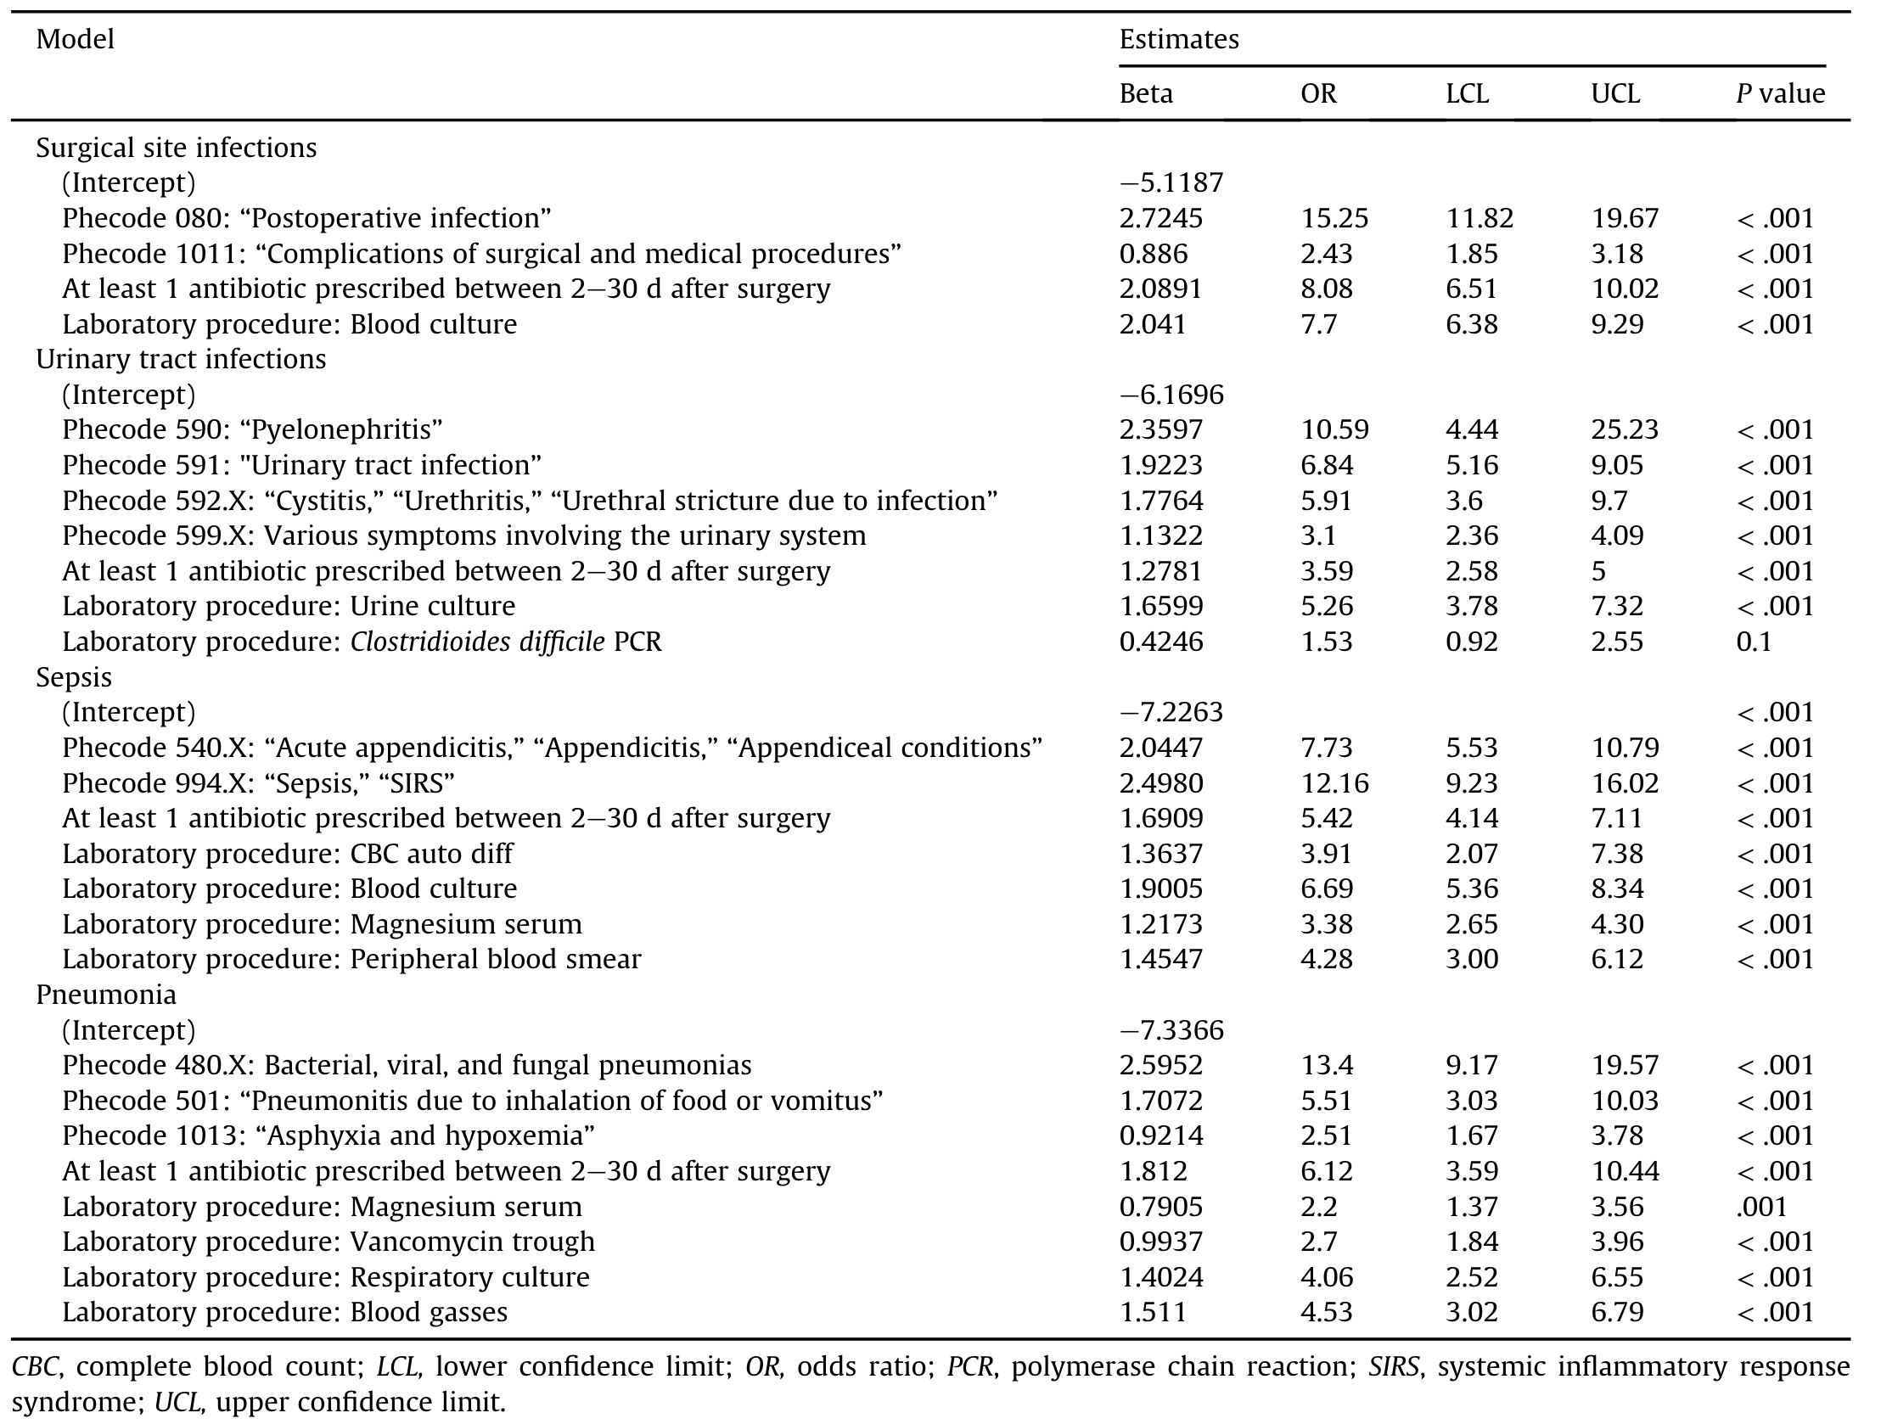
Monitoring and Surveillance
Retrospective study to develop and validate parsimonious, interpretable models for conducting surveillance of postoperative infections using structured electronic health records data.
Primary outcome: Comparison to curated dataset of postoperative outcomes data from the American College of Surgeons National Surgical Quality Improvement Program.
Predictor variables included coding diagnoses and procedures, inpatient medications, demographics, lab results.
Analytic approach: penalised regression with knockoffs framework.

Slide 11
Data-driven infection diagnosis
Why?
When?
What?

Slide 12
Applications of data-driven infection diagnosis
Prediction of serious bacterial infection
Early detection of septic shock
Early detection of serious bacterial infection
Highlight for specialist input
Learning health system
Prediction of sepsis
Early rationalisation of antibiotics
Outbreak detection
Early recruitment to clinical trials
Service monitoring and evaluation

Slide 13
Illness onset
Treatment
Well
Pre-symptomatic
Symptomatic
Treatment response
Outcome
Time

Slide 14
Illness onset
Treatment
Well
Pre-symptomatic
Symptomatic
Treatment response
Outcome
Prediction
Enhanced monitoring
Prophylaxis
Pre-emptive treatment
Time

Slide 15
Illness onset
Treatment
Well
Pre-symptomatic
Symptomatic
Treatment response
Outcome
Prediction
Early warning
Early treatment
Prognostication
Time

Slide 16
Illness onset
Treatment
Well
Pre-symptomatic
Symptomatic
Treatment response
Outcome
Prediction
Early warning
Detection
Early treatment
Clinical decision support systems
Early specialist input
Recruitment to clinical trials
Time

Slide 17
TREATMENT
Illness onset
Start
Refinement
End
Well
Pre-symptomatic
Symptomatic
Treatment response
Outcome
Prediction
Early warning
Detection
Refinement
Clinical decision support systems
Early treatment escalation or de-escalation
Time

Slide 18
TREATMENT
Illness onset
Start
Refinement
End
Well
Pre-symptomatic
Symptomatic
Treatment response
Outcome
Prediction
Early warning
Detection
Refinement
Confirmation
Surveillance
Outbreak detection
Service planning
Time

Slide 19
Applications of data-driven infection diagnosis
Pre-treatment initiation applications
Prediction of serious bacterial infection
Prediction/Early detection of deterioration e.g. sepsis or septic shock
Early detection of serious bacterial infection
Post-treatment initiation applications
Early rationalisation of antibiotics
Early specialist input
Recruitment to clinical trials
Delayed applications
Surveillance and cluster detection
Service monitoring and evaluation
Learning health system

Slide 20
Well
Pre-symptomatic
Symptomatic
Treatment response
Outcome
Information availability varies across timepoints
Time

Slide 21
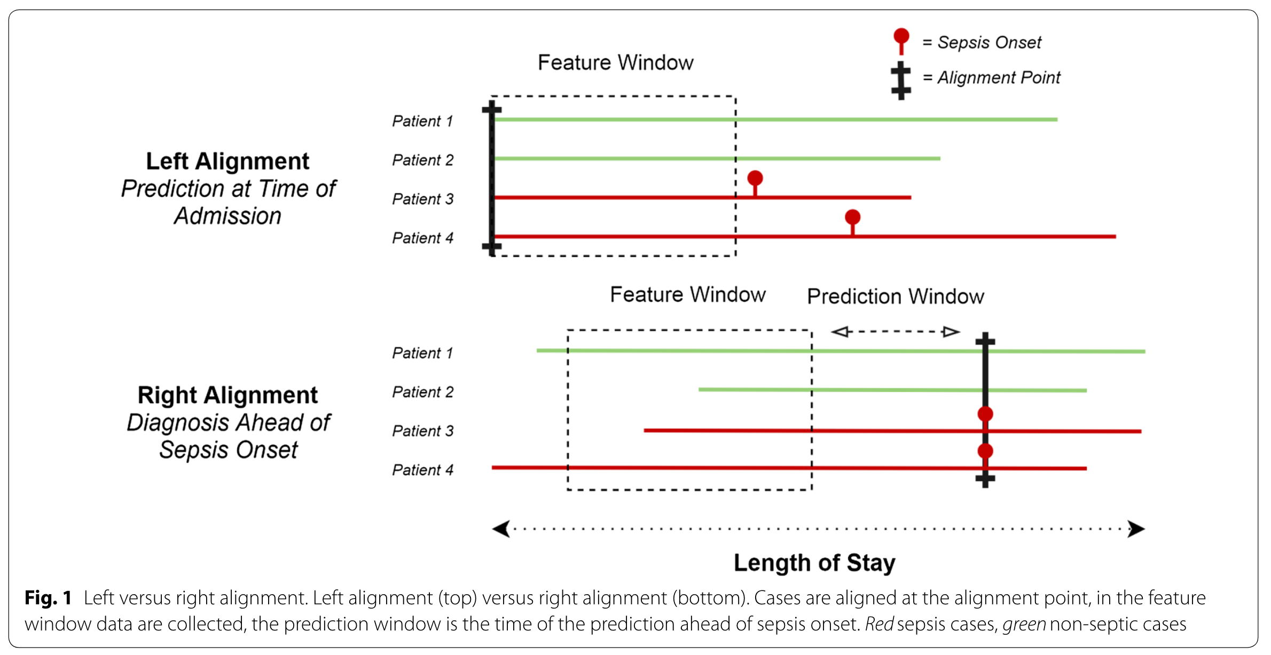
Prediction time frames
Fleuren et al., ICM 2020

Slide 22
Defining serious bacterial infections
All acute presentations
All acute presentations &
treated as bacterial infection define relevant sampling frames (i.e. derivation populations) for model development.
Need to define extractable EHR proxies of serious bacterial infection to define reference standard.
Serious bacterial infection
Treated as bacterial infection

Slide 23
Defining serious bacterial infections
Serious bacterial infection
Blood stream infection
Possible extractable EHR proxies:
Serious bacterial infection?
Microbiologically confirmed?
Blood stream infection?
Sepsis?
Microbiologically confirmed SBI
Sepsis
Linder et al., Lancet Digital Health 2023

Slide 24
Defining serious bacterial infections
Common infection syndromes

Slide 25
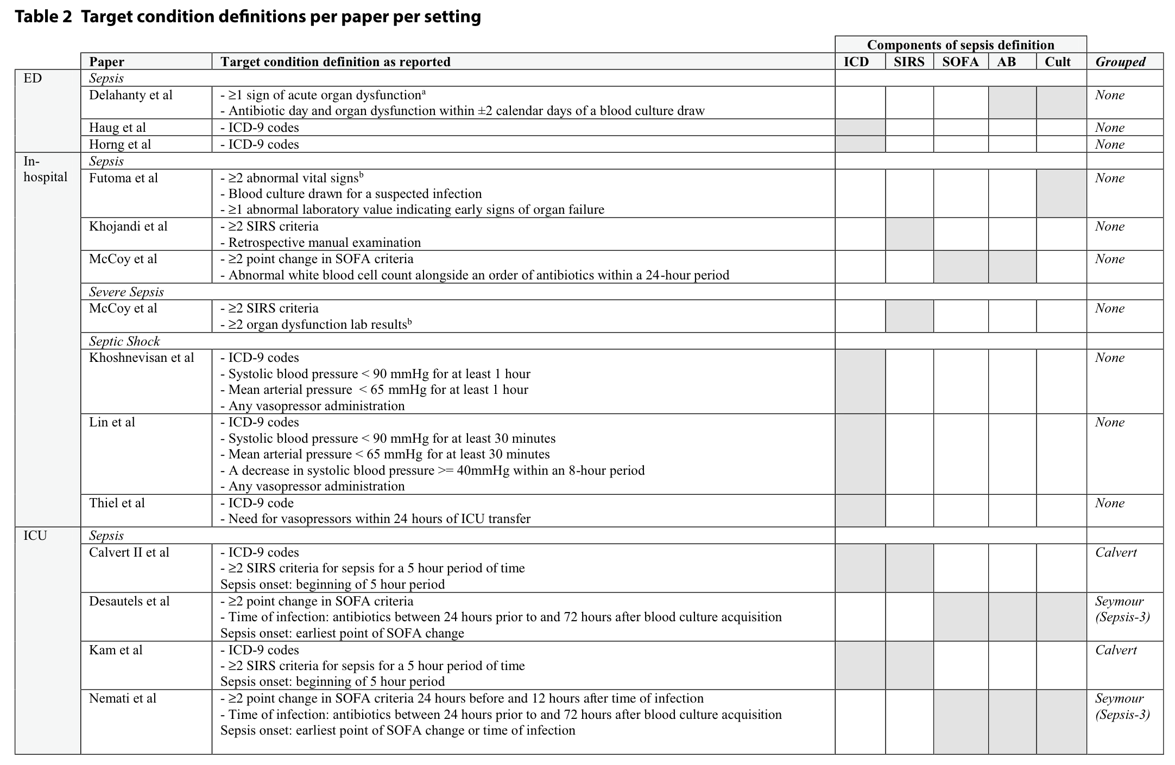
Defining serious bacterial infections
Fleuren et al., ICM 2020

Slide 26
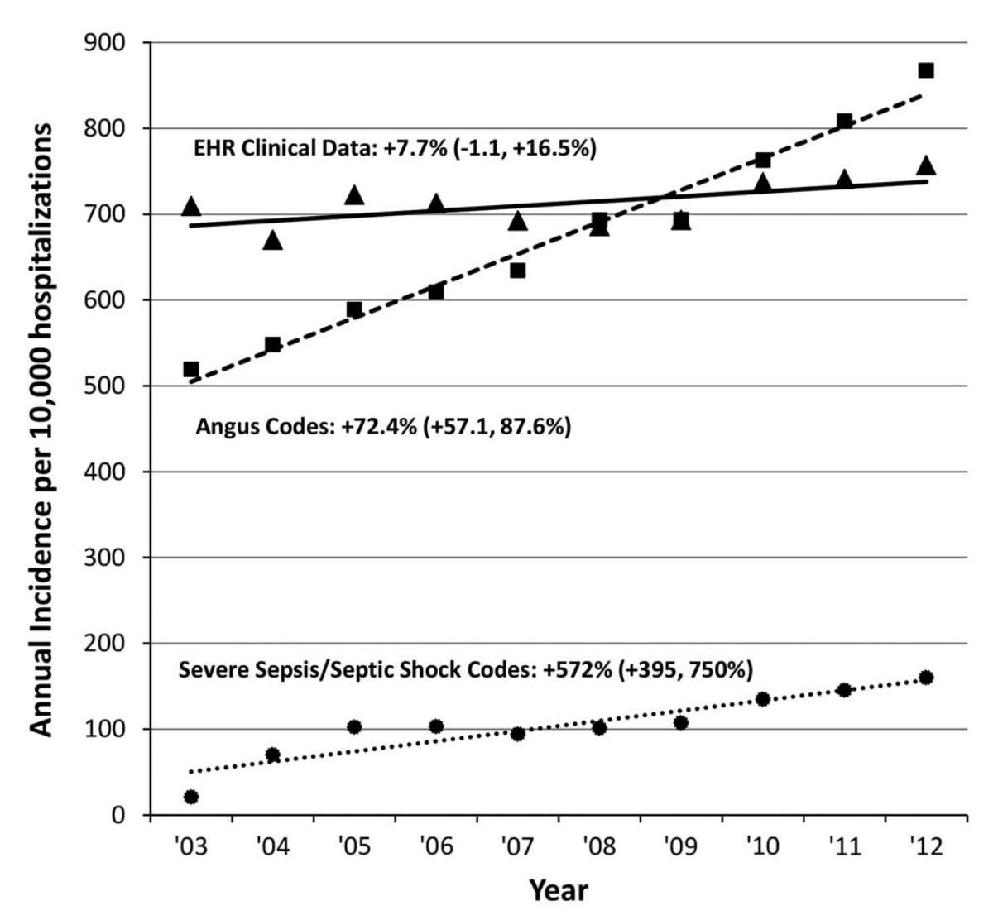
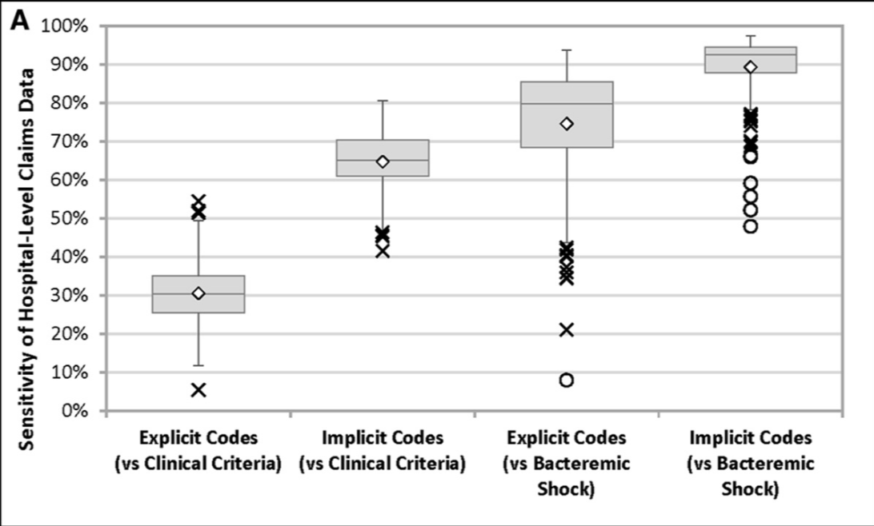
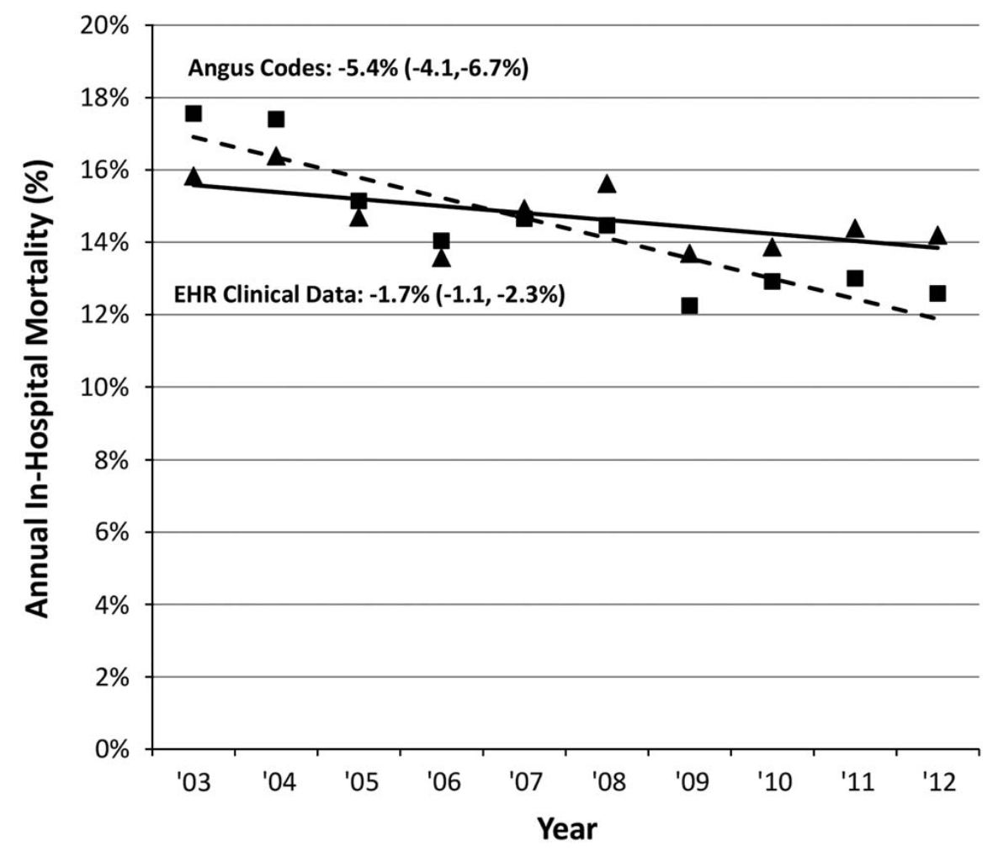
Defining serious bacterial infections
Claims based (or clinical-coding based) diagnoses of sepsis have poor sensitivity verses objective clinical criteria extracted from EHR based on suspicion of infection (cultures and/or (V Abx) and organ dysfunction.
Automatically extracted criteria may ‘over call’ sepsis if organ dysfunction not attributable to sepsis or ‘miss’ sepsis if less than defined minimum duration of Abx given.
Rhee et al., Infect Control Hosp Epidemiol 2016; Rhee et al., Crit Care Med 2019

Slide 27
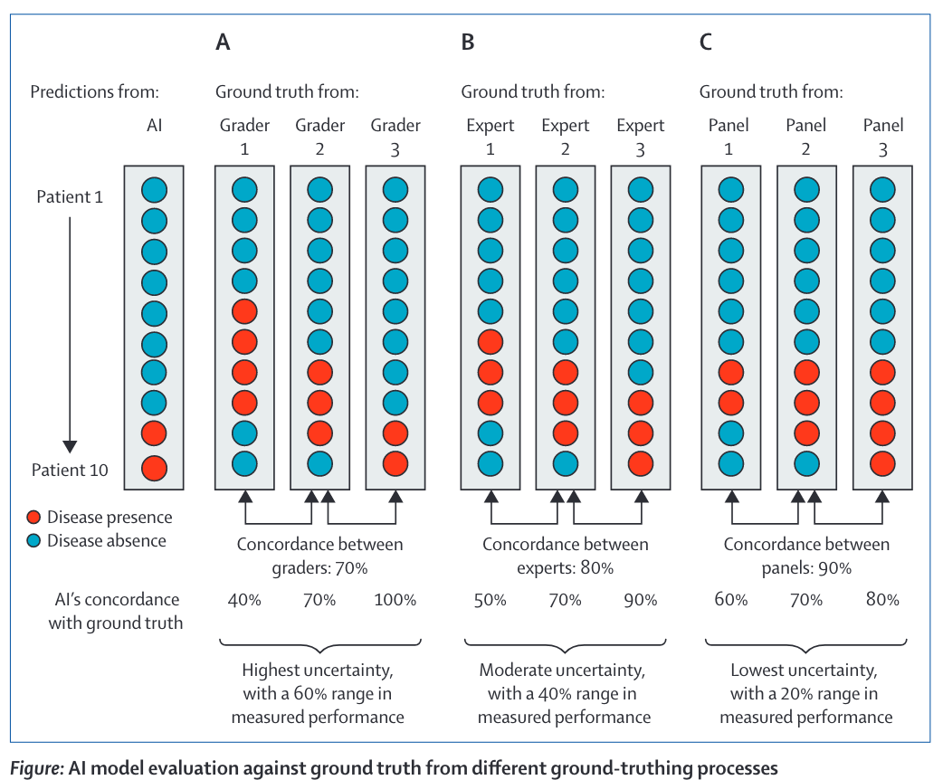
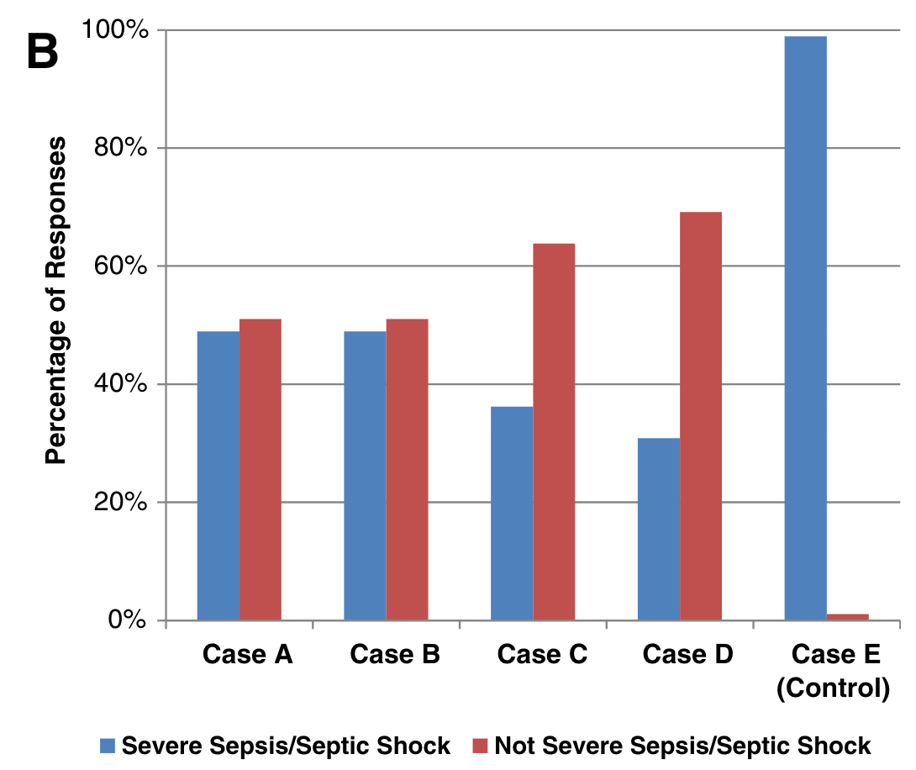
Defining serious bacterial infections
Improving reproducibility of ‘ground-truthing’ processes
Increase expertise of graders
Increase number of graders for each case
Ensure unbiased disagreement resolution process
Diagnosing sepsis is subjective and highly variable: a survey of intensivists using case vignettes
”…agencies must avoid a precautionary approach that holds AI systems to such an impossibly high standards that society cannot enjoy their benefits.”
Rhee et al., Crit Care 2016; Chen et al., Lancet Digital Health 2021

Slide 28
Data-driven diagnosis of serious bacterial infection
OVERALL AIM:
Use machine learning approaches to derive and validate data-driven diagnostic signatures of serious bacterial infection in patients assessed in emergency departments with clinically-suspected infection.
SPECIFIC OBJECTIVES:
Investigate the impact on model accuracy of utilising different approaches to data labelling of varying resource requirements: clinical coding, microbiological, composite +/- manually curated.
Investigate the impact on model accuracy of systematically incorporating proxies of existing comorbidities and past medical history.
Update outcome prediction at key clinical nodes: treatment initiation and treatment review.
EXPLORATORY OBJECTIVES:
Explore syndrome specific vs overall SBI models
Derive syndrome specific models for surveillance purposes based on data available at treatment completion

Slide 29
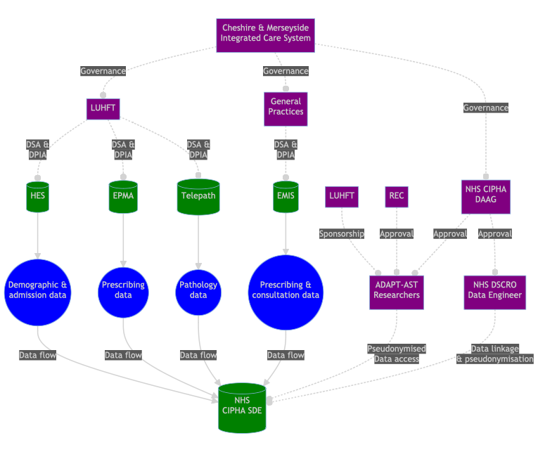
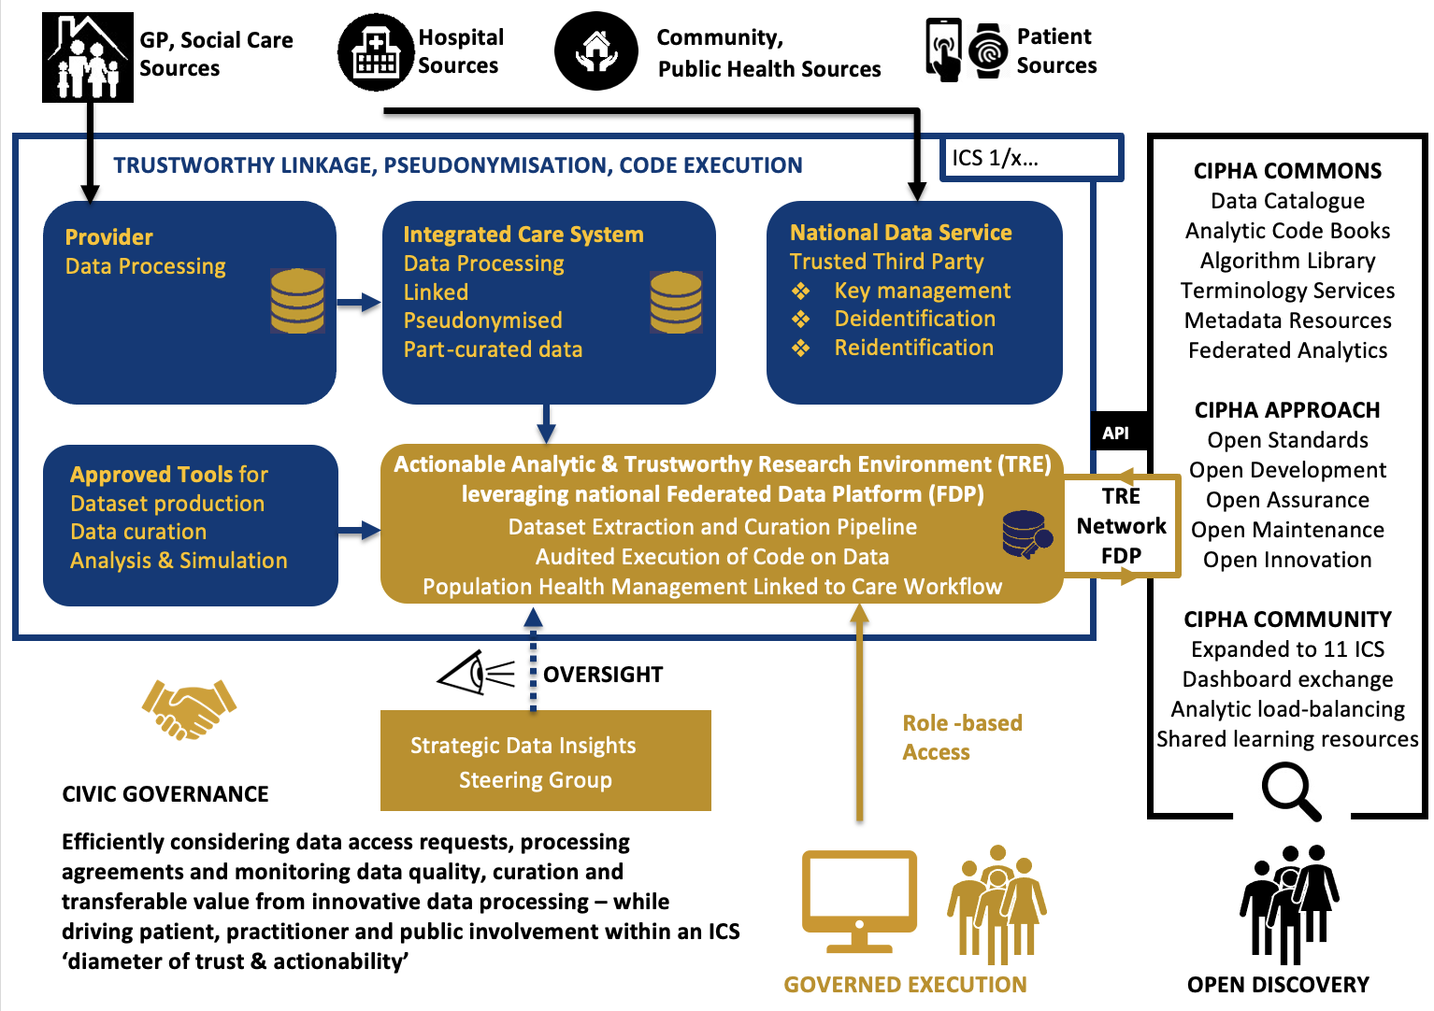
Liverpool Secure Data Environment – Current configuration
Ainsworth J, Buchan I. Combining Health Data Uses to Ignite Health System Learning. Methods Inf Med. 2015;54(6):479-87

Slide 30
Potential datasets
Dataset | Primary Care | Hospital Care
Demographics | Age, Sex, Residence | Age, Sex, Residence
Administrative | Consultations, Other appointments | Admission, transfer, discharge dates
Clinical coding | Acute and chronic illnesses (READ –> SNOMED-CT) | SUS/HES - Primary and secondary diagnoses (ICD10); Procedural codes (OPCS-4)
Laboratory | Microbiology Other laboratory (infrequent) | Microbiology Other laboratory (monitoring)
Observations | ? | Triage and routine monitoring
Prescribing | Acute and recurrent | Inpatient and TTOs
Standard Forms | N/A | Standard assessments (e.g., VTE, MUST)
Free text | Consultation notes | Clinical notes ?exceptions e.g. triage assessment, radiology requests

Slide 31
Sampling frame
General criteria for data use
Inclusion criteria Adult aged >=18 years AND Admission to LUHFT acute hospital site between 1st April 2017 and 31st October 2023 AND Complete consultant episodes registered on patient administration system. Exclusion criteria Registered ‘opt out’ from use of medical records for population health and research purposes
Analysis specific criteria: Identify any serious bacterial infection in those with clinically suspected / possible infection
At least ONE of the following must be present to identify record as possible infection: At least one antibiotic prescription (excluding prophylatic antibiotics) OR A blood culture request OR Clinical coding diagnosis for infection syndrome AND Inpatient death
Analysis specific criteria: Identify serious bacterial infection in all acute attendees
Use general criteria
Considerations
Clinician pre-existing biases in preselected suspected infection population.
Class imbalance and less clinically-applicable in all-comer group.

Slide 32
Reference Standard: Any serious bacterial infection
Reference standard | Proposal | Advantages | Disadvantages
Bloodstream infection | Significant pathogen, excluding contaminants | Objective Straightforward | Insensitive Restricts sampling frame to patients with cultures
Microbiology | As per Lee paper minus sepsis criteria | EHR extractable | Insensitive Restricts sampling frame to patients with cultures
Clinical coding | Explicit codes for sepsis plus major infection codes (SOS bundle) | EHR extractable | Uncertain and variable accuracy
Composite | As per Lee including sepsis criteria +/- physiology & biomarker response | Potentially EHR extractable | Circularity bias
Clinician adjudicated | Manual notes review with bespoke extraction tool with interrater agreement in sample vs. all | Robust, clinically credible | Hugely laborious for ?limited gain; inconsistency; information governance – re-identification loops

Slide 33
Performance Evaluation Measures
Diagnostic accuracy at baseline – Pre-treatment initiation
Sensitivity, Specificity, AUROC, PPV, NPV, Precision-Recall
Diagnostic accuracy at treatment review – 48-72 hour node
Sensitivity, Specificity, AUROC, PPV, NPV, Precision-Recall Optimise calibration for low risk strata
Model diagnostics
Feature importance assessment – Added value of comorbidity data?

Slide 34
Data parameters - Feature set
 | Variables
Demographics | Age, Sex, LSOA, Ethnicity
Administrative | Admit date, time, location
Clinical coding | See next
Microbiology | Prior urine, blood, sputum, sterile site samples last 6 months: specimen date, type, culture, organism code; specimen specific details
Other laboratory | Hb, Plt, WCC, Neut, Lymph, Mono, Na, K, Urea, Creat, eGFR, ALP, ALT, Bil, GGT, INR, PT, APTT, Lactate, pH, HCO3, paO2, PaCO2, Glucose, Albumin, Ca, PO4, Mg (First, Min, Max, Mean, Median)
Observations | Temp, HR, RR, FiO2, SBP, DBP, Sat, AVPU (First, Min, Max, Mean, Median)
Prescribing | Acute & Recurrent prescriptions last 6 months
Considerations
Assess full and limited feature sets -> ease of implementation
Data cleaning, scaling and imputation approach?

Slide 35
Categorising past medical history
Pre-defined and selected comorbidities
Literature review and expert consensus
Data-driven approach
All codes
Composite measures
Charlson comorbidity index
Elixhauser Method
Comorbidity count – Weighting?
Primary care - Pre-existing code (e.g. OPEN Safely) mapping SNOMED-CT to broad diagnoses e.g. chronic liver disease.
Secondary care – Analogous packages for HES?

Slide 36
Machine learning approach
Preferred Supervised ML approaches – to be determined
Multiple data types
High dimensionality
Repeated measures - Infection risk calculated at baseline and 48-72 hours.
Dynamic vs static windows/nodes
Chief considerations
Interpretability
Non-linear associations
Implementation
Assess limited models – based on reduced parameters
Assess added values of comorbidity data – requires more complex data integration.

Slide 37
Discussion points
What is the optimal sampling frame?
All comers or suspected infection?
Tackling the reference standard problem
Data driven approaches to dealing with labelling uncertainty
Semi-supervised approaches
How to best utilise prior comorbidity and infection treatment information
Any value in tackling syndrome specific diagnostic models
Relevant to stewardship
Important for surveillance - > learning health systems
Approach to incorporating information accrued after initial treatment initiation node?
Dynamic vs static nodes

